Slide 1
Pervasive Software Engineering
Introduction of Pervasive Computing
Week 1
S. Pradono Suryodiningrat
satrio.pradono@binus.ac.id

Slide 2
Session Learning Outcomes
Upon completion of this session, students are expected to be able to
LO 1 - apply design and development principles in the construction of pervasive systems
LO 3 - analyze a problem, identify and define the computing requirements appropriate to its solution

Slide 3
Agenda
About COMP6506-Pervasive Software Engineering course
Project
Perspective of Pervasive Computing
Challenges
Technology

Slide 4
About COMP6506-Pervasive Software Engineering course

Slide 5

Course Description
Learn methods:
used in large scale software development projects,
emphasizing requirements analysis,
design,
implementation,
and testing
A major focus will be on components that build pervasive computing systems: smart devices, smart environments, and smart services and interactions with users

Slide 6
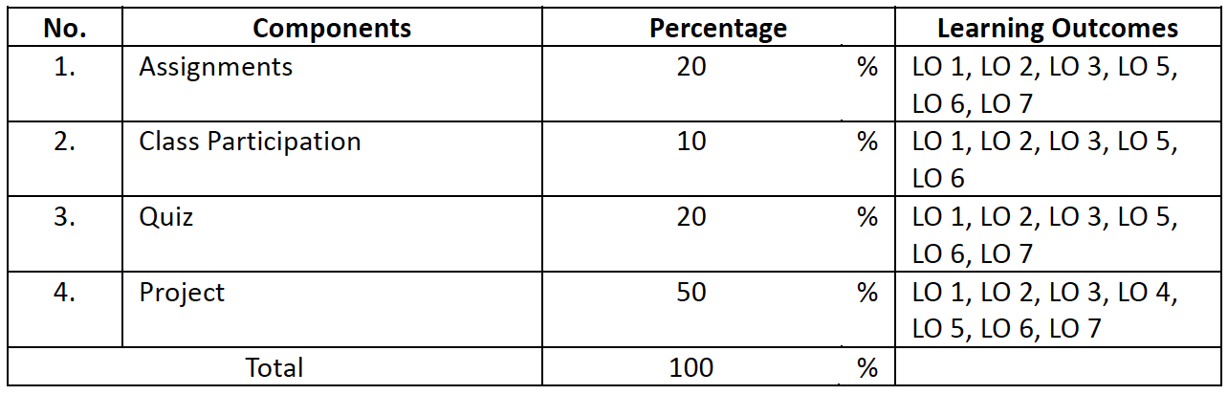
Course Structure
Lecture
Workshop

Slide 7
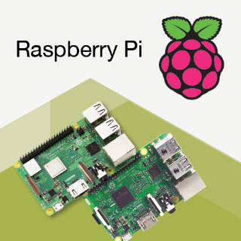
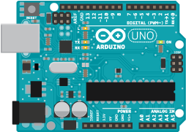
Course Requirements
Software design & development tools
Arduino
Raspberry Pi

Slide 8
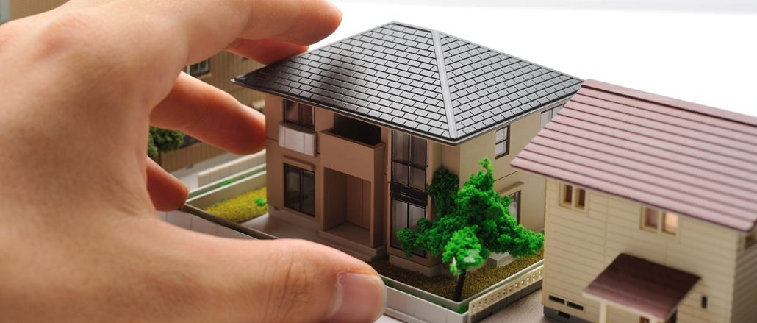
Project
Group of 2
Product prototype – need to be submitted to BiNus
A1 Poster – print
Video

Slide 9
Project References
https://www.youtube.com/watch?v=IofUhxkwY60
https://www.youtube.com/watch?v=W-2WZe9_mBc
https://www.youtube.com/watch?v=LSE_VK-t-X8
https://www.youtube.com/watch?v=PS0Sd4JlV20
https://www.youtube.com/watch?v=2U40IWBS3Dk
https://www.youtube.com/watch?v=l9Ab8or9nh8
https://www.youtube.com/watch?v=alwuYtvHymY
https://www.youtube.com/watch?v=H5MjYnps2I0

Slide 10
Suggested Equipment
Arduino : UNO, Mega, etc
Raspberry Pi : 3 Model B, 3, etc
Breadboard : Large, Medium, or Mini
LED : Large, Medium, or Mini
Jumper wires : Male-male, Male-female
Resistor : Various
Battery + wire, or USB A-B
USB Cable + powerbank (optional)
ESP8266 + adapter (optional)
Monitor + HDMI Cable + Mouse + Keyboard (if the OS and Network are not prepared before)
Laptop or Desktop

Slide 11
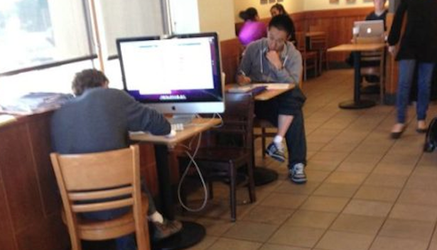
But if you bring your Desktop, you may end up like this..

Slide 12
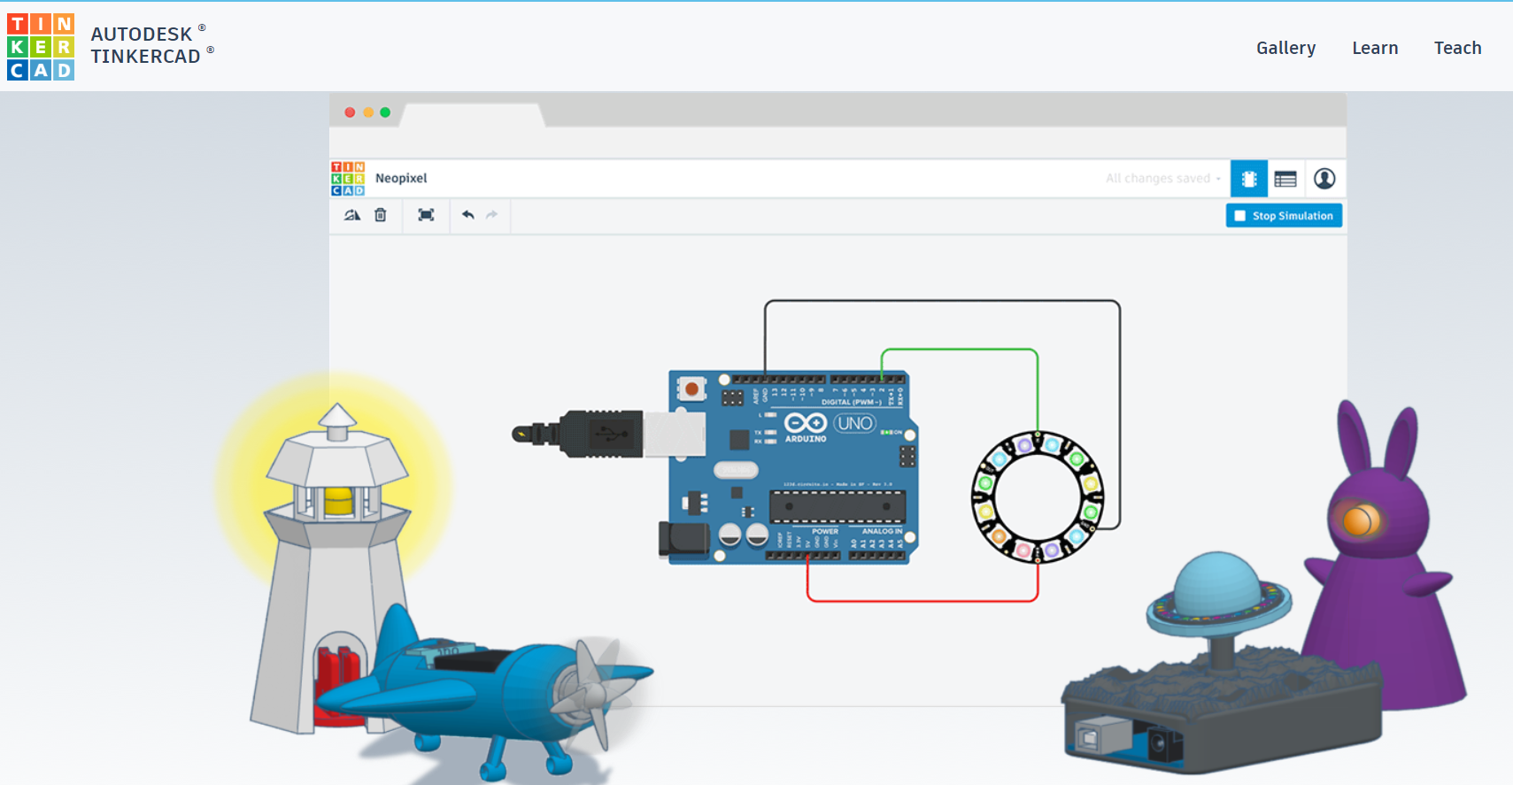
Good news for you.. There is a simulation tools that you can try..
https://www.tinkercad.com/circuits

Slide 13
Perspective of Pervasive Computing

Slide 14
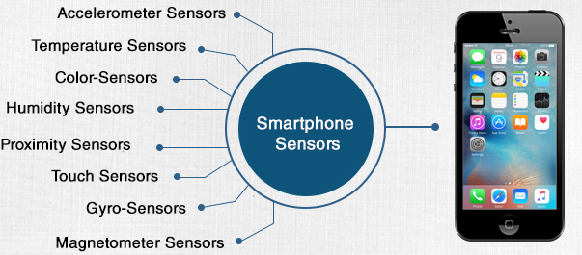
Technology Trend Overview
The advance of mobile computing, cloud computing, wearable computing, and smart devices has brought unprecedented opportunities for pervasive computing.
Sharp rise:
Smartphones
Multicore CPUs
Gigabytes of memory
Wi-Fi
Cellular communication components
GPS
Other sensors
Smart pads
https://myphonefactor.in/2012/04/sensors-used-in-a-smartphone/

Slide 15

Technology Trend Overview
Soon, these devices will have more:
Powerful information storage
Processing capabilities
than desktop computers
Million of apps have been developed for these mobile devices that provide a wide variety of personalized services.

Slide 16
Growth of Computing Technology
Standalone computer Vs. networked computers
Distributed computing (starting from about 20 years ago)
A computing job may be divided into sub-tasks to be performed by different processing units (in parallel/ or sequentially) which are connected by a network
Mobile computing (starting from about 10 years ago)
The users may move around and computing units (notebooks, laptop, etc.) are carrying by users
The system supports computing task requests from moving users through a wireless network
High connectivity (both fixed and mobile)
The computing units are connected if necessary (even moving) and work together cooperatively to complete a job request
Why do we have such a computing trend?

Slide 17
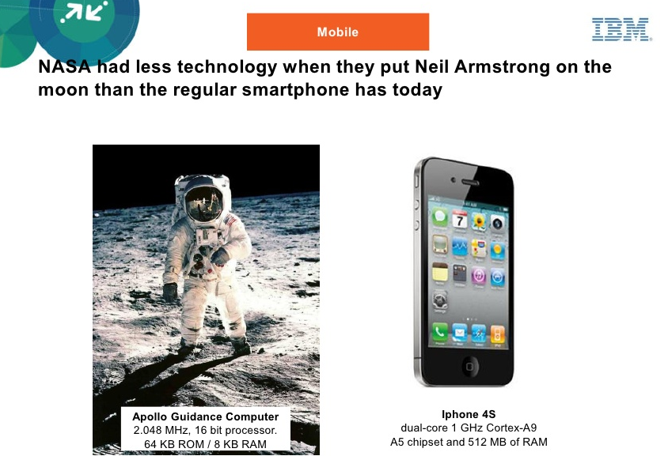
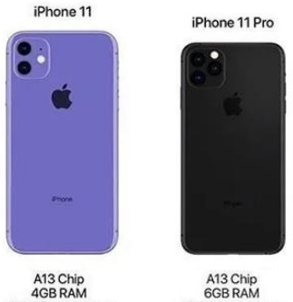
64-bit six-core CPU, with two high-performance cores running at 2.65 GHz

Slide 18
Some Definitions
Ubiquitous/Pervasive computing
It is everywhere
It is invisible, you don't notice it (minimal intervention)
It is inside things, in the infrastructure
Effectively communicate and perform useful tasks
It is integrated into your everyday life
Mobile computing
It can move around and no wire connected (wireless)
Distributed computing
It may be static (fixed locations and wired connection)
Why wired connections?
A task is divided into sub-tasks for parallel/sequential processing
Notes:
present, appearing, or found everywhere.

Slide 19
Some Definitions
Pervasive computing is roughly the opposite of virtual reality, where virtual reality puts people inside a computer-generated world
Pervasive computing forces the computers to live out here in the world with people (become parts of our world)
Computers become not computers
“.. Make a computer so imbedded, so fitting, so natural that we use it without even thinking about it.”
Computations are performed in every part of our life to enrich our living and improve our ability in responding to the changing environment
“In the 21st century the technology revolution will move into the everyday, the small and the invisible …The most profound technologies are those that disappear. They weave themselves into the fabrics of everyday life until they are indistinguishable from it.”

Slide 20
Technology Trend Overview
Previous pervasive computing was often limited by the physical size of the electronic devices
However, this constraint has been overcome by rapid technological developments.
iWatch
Samsung galaxy watch
Sony SmartWatch
Google Glass

Slide 21
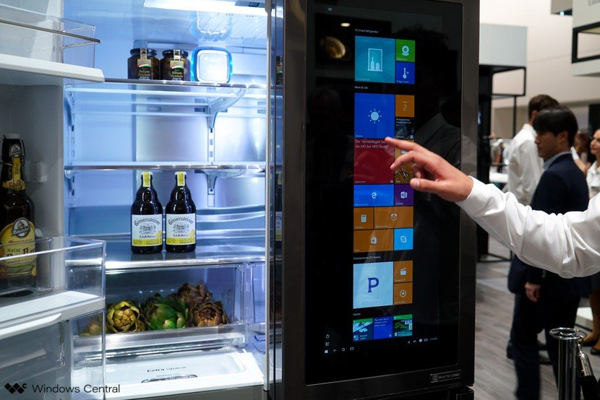
Technology Trend Overview
Many traditional appliances as now embedded with sensors and communication components (making them smarter)
Smart Sofa
smart refrigerator
Smart TV
https://www.windowscentral.com/lg-smart-instaview-refrigerator-windows

Slide 22
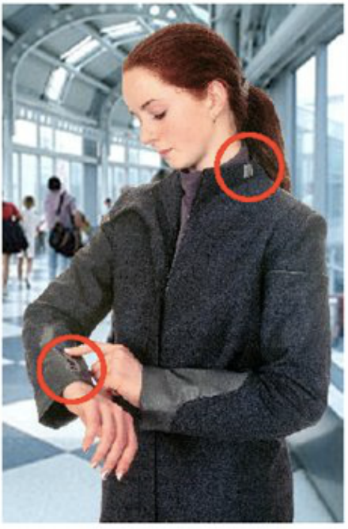
Smart Clothing
Conductive textiles and inks
print electrically active patterns directly onto fabrics
Sensors based on fabric
e.g., monitor pulse, blood pressure, body temperature
Invisible collar microphones
Kidswear
game console on the sleeve?
integrated GPS-driven locators?
integrated small cameras (to keep the parents calm)?

Slide 23
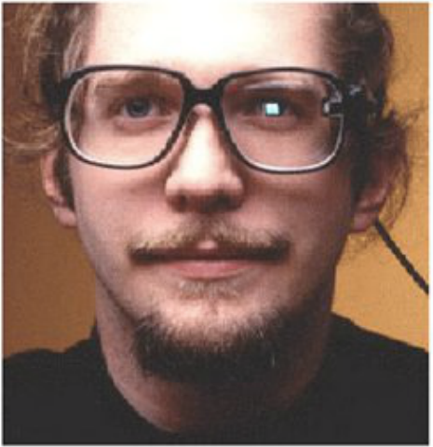
Smart Glasses
By 2009, computers will disappear. Visual information will be written directly onto our retinas by devices in our eyeglasses and contact lenses-- Raymond Kurzweil
What can you do by using this device?

Slide 24
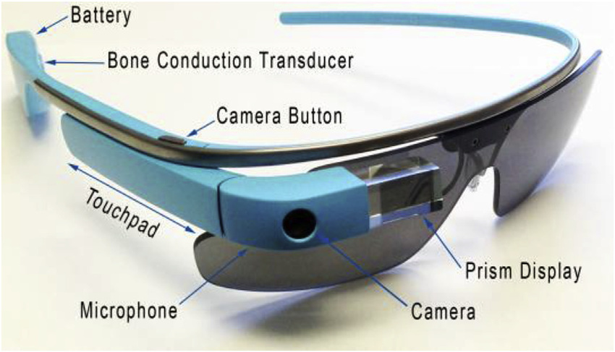

Slide 25
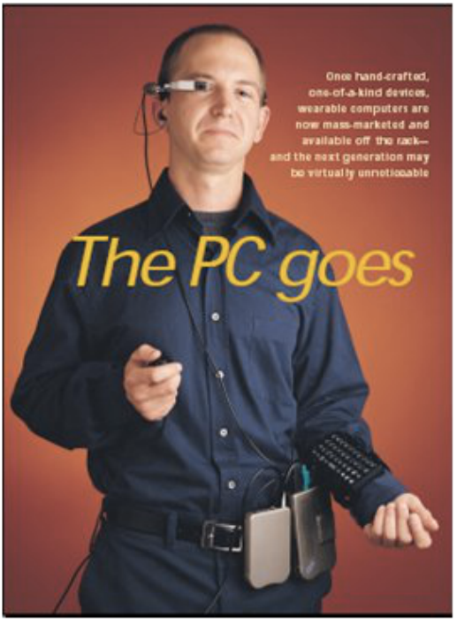
Todays Wearable Computer
What can you do with this device?
www.xybernaut.com

Slide 26
Discussion
What can a smart sofa do?
Any other “smart” traditional appliances? (except smart sofa/smart refrigerator/smart TV/smart watch/smart glasses/smart clothing)
Mention the appliances!
What can they do?

Slide 27
Pervasive Computing: Concepts
Pervasive computing is a new wave of technology where computing takes the place everywhere and anywhere.
Goal = to become a technology that disappears.
Pervasive computing can be seen as:
An enabler technology for many new and exciting applications
Making information accessible to anyone, anywhere, and at any time

Slide 28
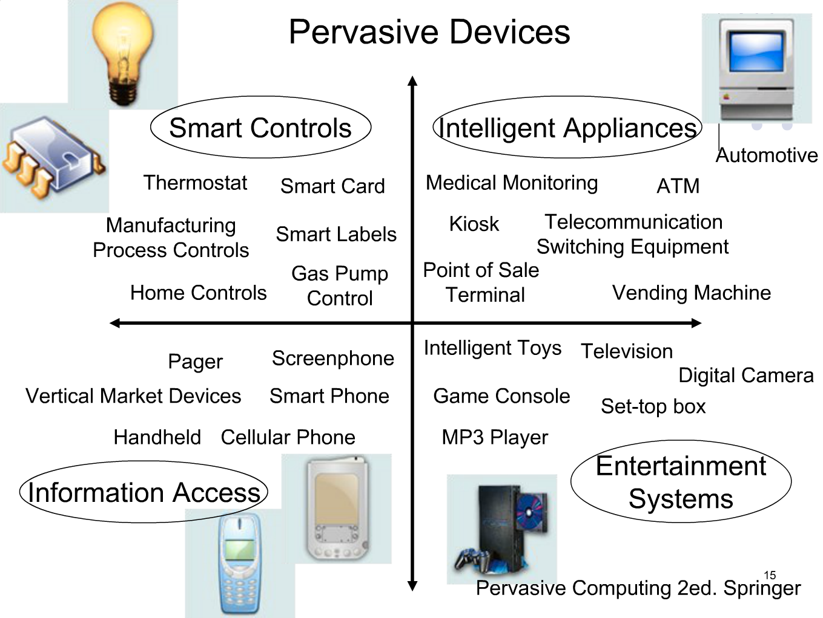
Hansmann, U., Merk, L., Nicklous, M.S., & Stober, T. (2003). Pervasive computing: The mobile world (2nd ed.). Springer

Slide 29
Challenges

Slide 30
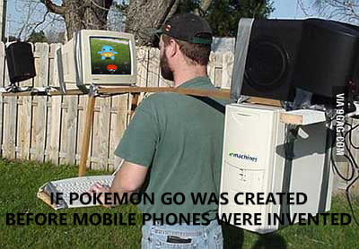

Slide 31

Challenges
Many challenges need to be overcome before the vision becomes real.
The main challenges faced in pervasive computing are as follows:
Transparency
Context awareness
Mobility
Heterogeneous devices
Data management
Fault tolerance
Reliability
Usability
https://brayve.net/wp-content/uploads/2019/08/7709/how-to-overcome-the-3-biggest-blogging-challenges-via-jamarketer.png

Slide 32
Challenges
Transparency
People-oriented, providing transparent services based on individual requirements, preferences, and so on.
Can use any device, in any location, and in any format, without an individual being consciously aware of what is taking place with respect to the actual computing
Context awareness
Very tightly connected with specific users
Often gather and store information on the user’s behavior context, habits, and planning.

Slide 33
Challenges
Mobility
Having devices move with the user or by having applications move among users’ devices
Applications need to adapt to the moving environment
Heterogeneous devices
Involve many different types of devices working in an orchestrated way
For instance, the application may switch from a desktop PC to a mobile phone
Heterogeneous devices complicate the development of high-level applications because different devices provide varied
Programming interfaces
Resource abstractions
Functional capabilities

Slide 34
Challenges
Data management
Many devices continuously produce huge amount of raw data
In order to provide meaningful semantics for high-level application, some preprocessing of the data may be necessary
Fault tolerance
Requires harmonious cooperation among many hardware devices and various software components
Both type of failures can hamper the effectiveness
Fault tolerance measures must be built into the system to avoid serious or fatal consequences for users

Slide 35
Challenges
Reliability
The systems normally are embedded in the environment not only for gathering information but also for making decisions or at least for decision support
Limited resources and unstable wireless communication can impact the reliability
Usability
An easy-to-use and intuitive interface is the demand of the future
Ease of use will follow different levels for different end users
Usability is very important and requires more attention than all other areas, such as desktop and Web-based applications

Slide 36
Technology

Slide 37
Technology
Pervasive computing involves state-of-the-art technology:
Middleware and programming model
Context-awareness computing
Resource allocation and management
Human-computer interaction (HCI)
Pervasive transaction processing
Data mining

Slide 38
Middleware
Pervasive application often rely on some middleware support.
Application programmers face a large variety of challenges:
Data management
Context management
Security and privacy issues
Mobility
It is more desirable to extract the common requirements from different applications and provide the desired functionality from a middleware layer, which hides the complexity and heterogeneity of underlying hardware and network platforms.

Slide 39
Context Awareness
Context refers to the pieces of information that capture the characteristics of pervasive computing environments.
Classification based on the context sources:
Physical context = aggregated by physical resources (example: wireless sensors, RFID, and so on.)
Virtual context = specified by users or captured from users interaction (example: preferences, business processes, goals, task, and so on)
Context awareness is a mechanism that assist pervasive application in adapting their behaviors to the evolving contexts.

Slide 40
Resource Management
Pervasive devices exhibit very different features and functions.
Resources in pervasive systems are limited and heterogeneous.
Efficient resource management policies play a very important role in pervasive computing (and also related to resource allocation).

Slide 41
Human-Computer Interaction
HCI provides channels for people to communicate with digital worlds.
In smart spaces, HCI marks itself off from tradition interaction with various computing devices (e.g., TV, smartphone, refrigerator, etc.) by incorporating diversifies interaction modalities (e.g., speech, gesture, face expression, etc.).
To achieve interaction migration in smart spaces, a Web service-based HCI migration framework will be introduced in which integration application logic an implicit approach to find user preferences by learning from past interactions with each individual user.

Slide 42
Discussion
Groupwork
Do lite research on the most unique and useful pervasive technology according to you.
What does it do?
How to improve it

Slide 43
Thank you

Slide 44
References
Guo, M., Zhou, J., Tang, F., & Shen, Y. (2016). Pervasive computing: concepts, technologies and applications (1st ed.). CRC Press
Resmini, A., & Rosati, L. (2011). Pervasive information architecture: designing cross-channel user experiences (1st ed.). Elsevier.
Monk, S. (2019). Raspberry Pi cookbook: Software and hardware problems and solutions (3rd ed.). O'Reilly Media.
Blum, J. (2019). Exploring Arduino: tools and techniques for engineering wizardry (2nd ed.). Wiley.
Martinez, J.J. & Dewanti, S.S. (2019). “Multimodal Interfaces: A Study on Speech-Hand Gesture Recognition”. Paper on International Conference on Information and Communications Technology. IEEE Xplore.

